Slide 1

IBM – NALAIYA THIRAN PROJECT

Slide 2
PERSONAL EXPENSE TRACKER APPLICATION
TEAM ID : PNT2022TMID44963
TEAM MEMBERS :
TEAM LEAD : KALAIYARASAN V – 811219104007
TEAM MEMBER : SARANYA P – 811219104020
TEAM MEMBER : RAVINIYA K – 811219104018
TEAM MEMBER : NANCY N - 811219104014

Slide 3
CONTENTS
OBJECTIVES
INTRODUCTION
PROBLEM DEFINITION
LITERATURE REVIEW
H/W AND S/W REQUIREMENTS
ADVANTAGES
SCREENSHOTS
FUTURE ENHANCEMENT
CONCLUSION
REFERENCE

Slide 4
OBJECTIVES
Also known as expense manager and money manager, an expense tracker is a software or application that helps to keep an accurate record of your money inflow and outflow. Many people in India live on a fixed income, and they find that towards the end of the month they don't have sufficient money to meet their needs.

Slide 5
INTRODUCTION
A refined system to efficiently manage his/her
expenses with ease.
Tracking expenses daily can really help to us save lot of money.
Stay in control and achieve your goal.
Able to generate your expense and saving report as time duration you selected.
Get reminder if pre-defined expenses exceeded.

Slide 6
PROBLEM DEFINITION
At the end of the month we start to have money crisis.
Lack of proper planning of our income.
Person has to keep a log in a diary or in a computer.
All the calculations needs to be done by the user.
Overload to rely on the daily entry of the expenditure

Slide 7
LITERATURE REVIEW
Quicken and Microsoft Money-desktop programs-2000,2008
QuickBooks-wrap up whole business-2008
YNAB-import expenses automatically-2013

Slide 8
H/W AND S/W REQUIREMENTS
SOFTWARE REQUIREMENTS
Operating system : Windows 10 OS
Front End : HTML, CSS, JavaScript
Back End : DB2
Framework : Flask
HARDWARE REQUIREMENTS
Processor : AMD PRO
RAM : 4 GB
Hard disk : 500 GB

Slide 9
ADVANTAGES
The best organizations have a way of tracking and handling these re-imbursements . This ideal practice guarantees that the expenses tracked are accurately and in a timely manner. From a company perspective , timely settlements of these expenses when tracked well will certainly boost employees' morale
Financially Aware and Improve Money Management tracking your expenditures ensures you achieve your project financial targets . How is that? By clearly understanding your project spending using project budget limits, you can aptly make the necessary changes to complete your project within time and budget.

Slide 10
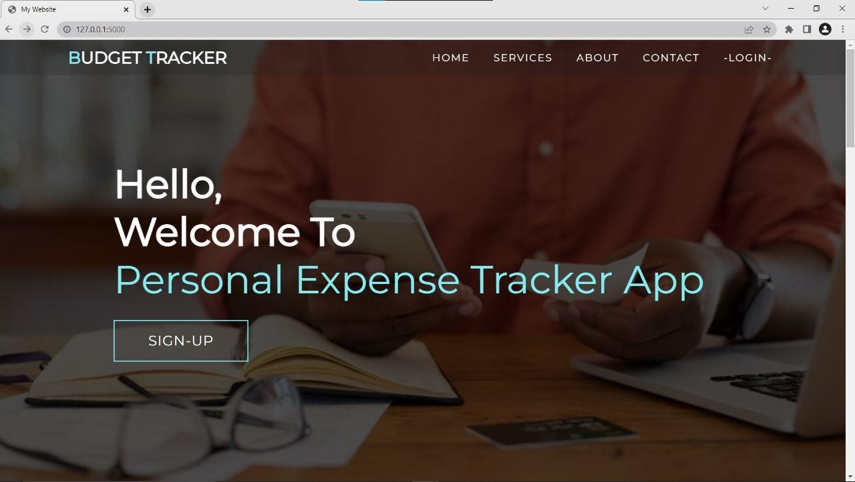
SCREENSHOTS

Slide 11
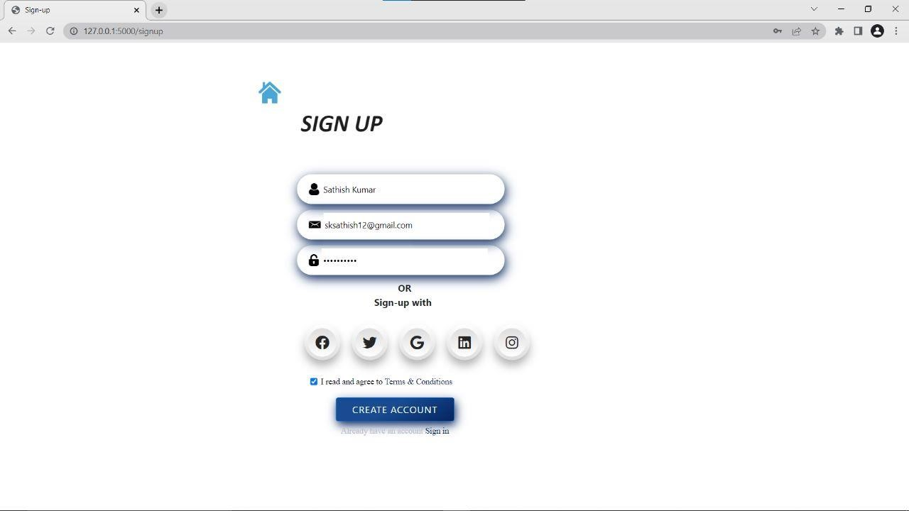

Slide 12
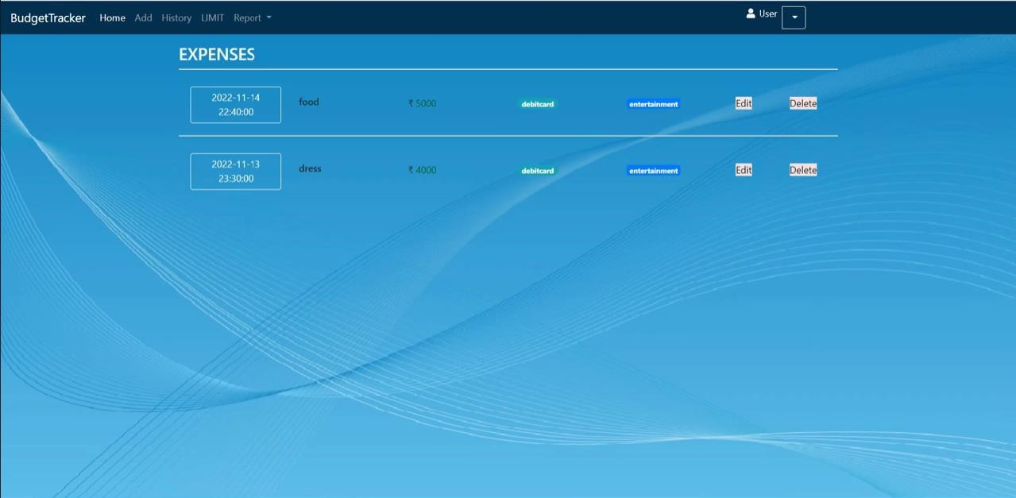

Slide 13
FUTURE ENHANCEMENT
The main objective of this project is support to the user to sustain all financial activities like digital automated dairy. This application helps the user to avoid unexpected expenses and bad financial situations.
Using this application, users can manage all financial data and track all expense and income category wise.
Creating a category and recording all expenses and income under the category.
Enable the notification system user get notification daily at a specific time that can help the user insert expense and income.
Backup and Restore all information.
Report are generated in PDF format in category wise or time period

Slide 14
CONCLUSION
In conclusion, developing a personal budget and tracking all expenses and spending is a crucial aspect of personal finances. Set aside a fixed amount in a savings account, they say you should always have three months work of your living expenses in a savings account in case of emergencies.

Slide 15
REFERENCE
https://moneyview.in/insights/best-personal-financemanagement-a pps-in-india
https://www.factmr.com/report/personal-finance-mobile-appmarke t
https://www.moneytap.com/blog/best-money-managementapps/
https://relevant.software/blog/personal-finance-app-like-mint/
https://www.onmanorama.com/lifestyle/news/2022/01/11/fin ancial-l iteracy-trend-among-todays-youth-investment.html

Slide 16
THANK YOU !

